Slide 1
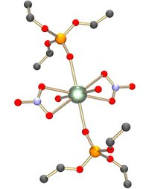
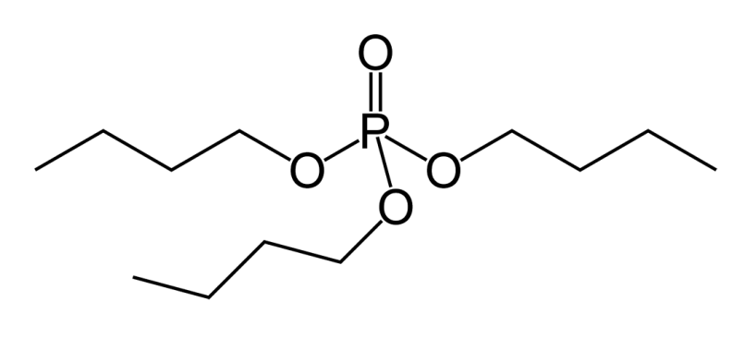
RDCH 702: Lecture 9 Separations Part 3
Separation methods
Solvent extraction
PUREX
Ion exchange
Volatility
Electrochemistry
Specific actinide separations
Basic concept of separations
Oxidation state
Ionic radius
Development of advanced separations
Trivalent actinides
Necessary for fuel cycle due to formation of mixtures due to fission
Actinides
Transuranics
Fission products
Se (Z=34) to Dy (Z=66)
Tributyl phosphate (TBP)

Slide 2
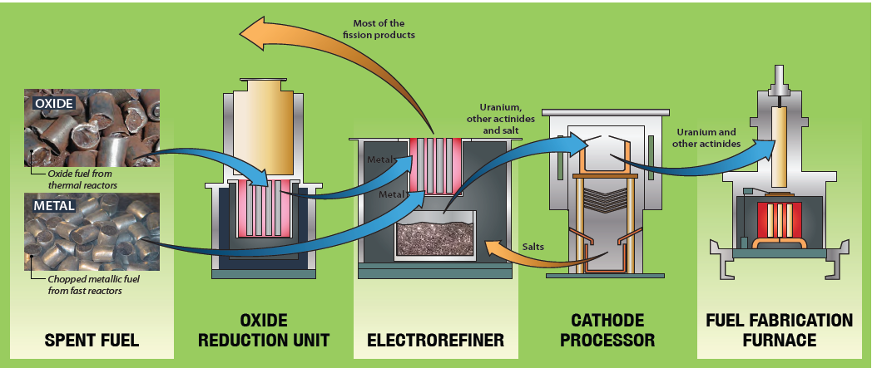
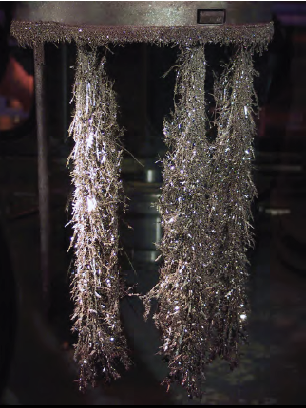
Pyroprocesses
Electrorefining/Electrochemistry
Uses molten salt as solvent
KCl-NaCl
Avoids problems associated with aqueous chemistry
Hydrolysis and chemical instability
Reduction of metal ions to metallic state
Differences in free energy between metal ions and salt
Thermodynamic data at hand or easy to obtain
Sequential oxidation/reduction
Cations transported through salt and deposited on cathode
Deposition of ions depends upon redox potential

Slide 3
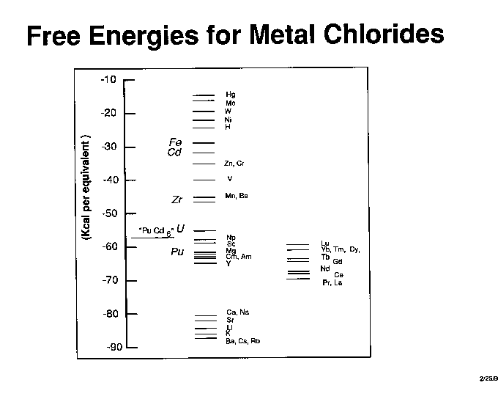
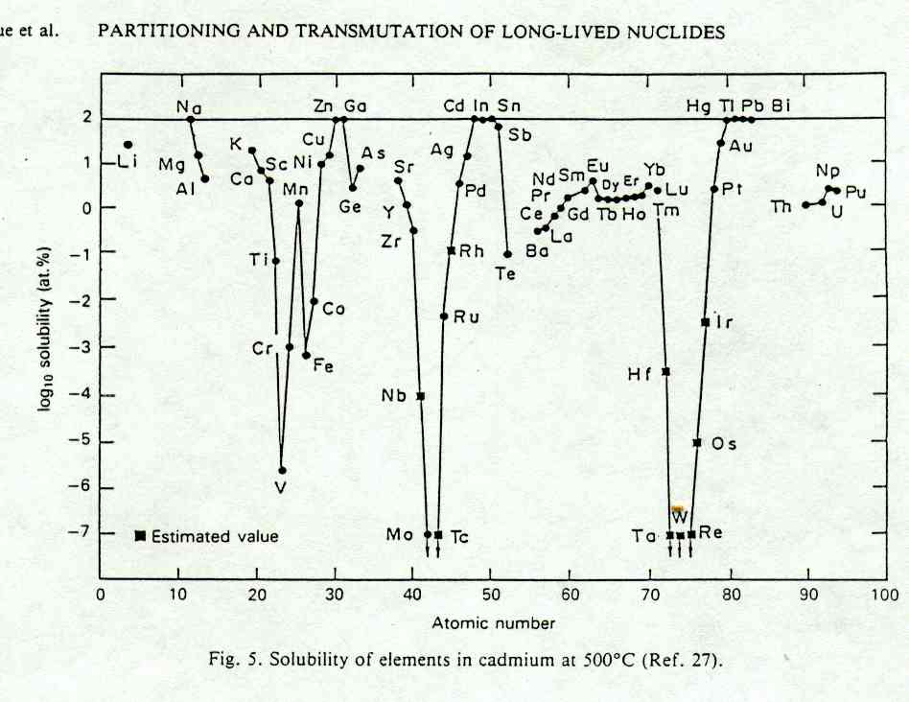
Electrochemical Separations
Selection of redox potential allows separations
Can use variety of electrodes for separation
Free energies
noble metals
iron to zirconium
actinides and rare earths
Group 1 and 2
Solubility of chlorides in cadmium
Explored at part of Integral Fast Reactor (IFR) program

Slide 4
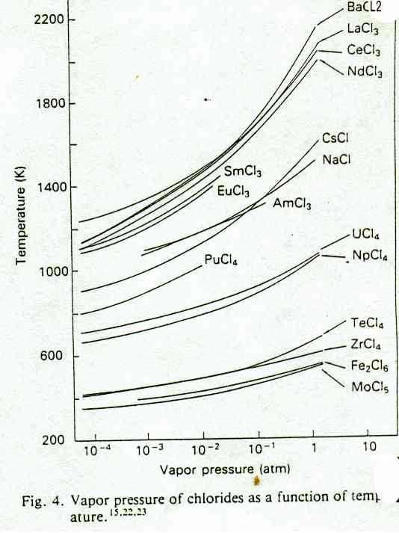
Molten Salt
Volatility of chlorides as separation basis
Gaps between groups
High vapor pressures achievable at low temperature

Slide 5
Molten Salt Example
Oxide fuel dispersed in CaCl₂ /CaF₂ at 800 °C
Inclusion of Ca metal reduces U salt to a metal
Reduced metals dissolved in receiver alloy
Example Cu - 40% Mg - Ca
Uranium exceeds solubility limits receiver alloy and precipitates
Pu, other actinides, rare-earths, and noble metal fission products accumulate in receiver alloy
Separated by distillation
Alkali metals (Rb and Cs), alkali-earths (Sr and Ba),and remaining iodine and bromine accumulate in the CaCl₂/CaF₂ salt.
Salt contains CaO from the reduction process
CaO is electrolytically reduced to metal for reuse

Slide 6
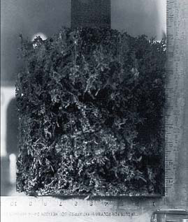
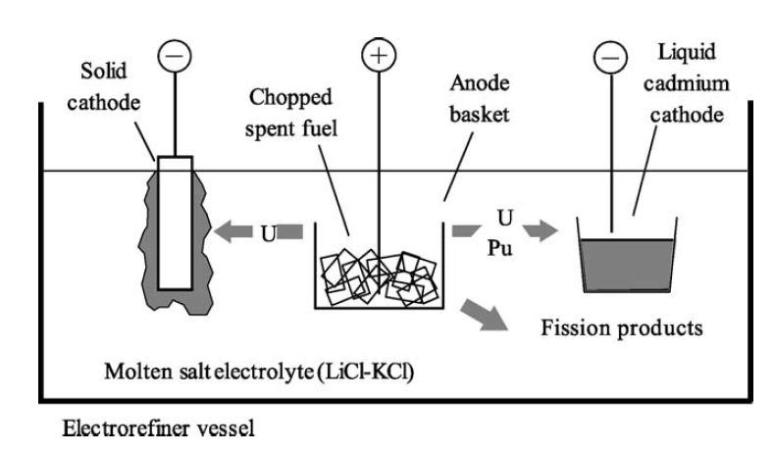
Molten Salt
LiCl-KCl-UCl₃ at 450-500 ºC
Chopped metallic fuel added to anode baskets
U oxidized at anode to U(III)
Reduced back to metal at cathode
Transuranics and fission products oxidized
Co-deposition of actinides with cadmium cathode

Slide 7
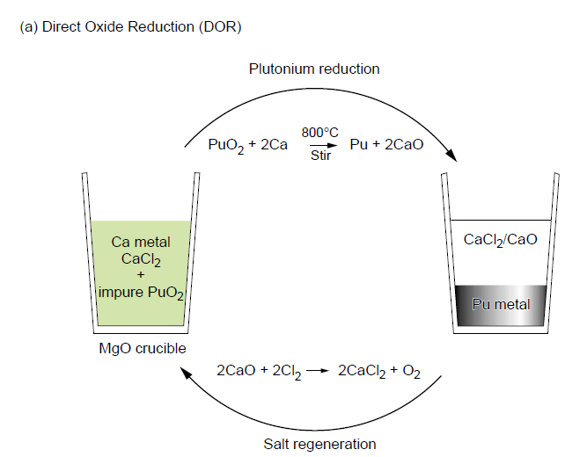
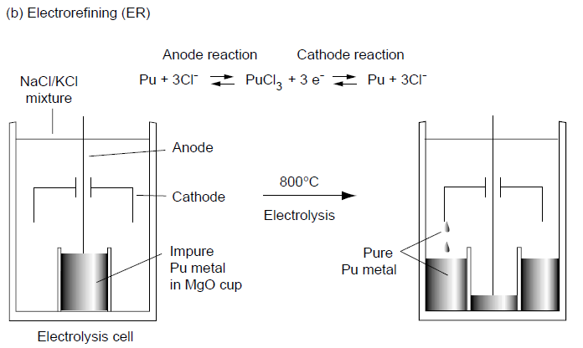
Pu Processing
DOR reduces plutonium dioxide to metal
PuO₂ and Ca/CaCl₂
Formation of Pu metal and CaO
CaO treated with Cl₂
Pu metal purified by electrorefining
Pu metal melted in NaCl/KCl at 800°C
Pu oxidized to PuCl₃,
dissolves in molten salt
PuCl₃ migrates to cathode and reduced
Pu metal drips from cathode and collects in annular region outside cup
ring of pure Pu produced

Slide 8
Ionic liquids
Room temperature ionic liquid (ILs) composed of ions that are liquid below 373 K
Composed of a bulky, unsymmetrical organic cation and an organic or inorganic anion
Range of possible pairs, can be task specific
Low vapor pressure
Ability to dissolve organic and inorganic compounds
Conductive
Wide electrochemical window
Ionic liquids are tunable to obtain properties needed for particular application
Solubility
Reaction Rate
Electrochemical window
Specific metal ion interaction

Slide 9
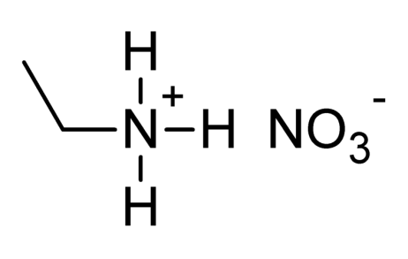
Introduction: Ionic liquids
Ethylammonium nitrate electrochemistry in 1914
Initial efforts focused on chloroaluminate anion (AlCl₄⁻)
Electroplate aluminum
J. Electrochem. Soc. 98, 203 (1951)
Detailed studies, identification of limitations with chloroaluminate
Moisture sensitivity
Requires non-ambient conditions
Inorg. Chem. 17, 2728 (1978)
Newer ionic liquids have non-hydrolyzing or stable anions
Moisture stable ionic liquids developed
JACS, 965 (1992)

Slide 10
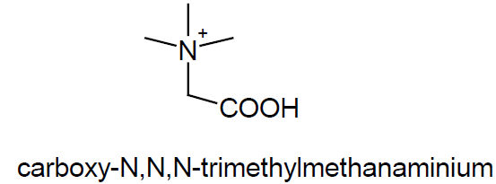
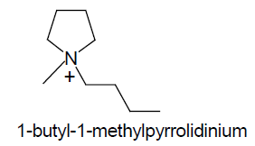
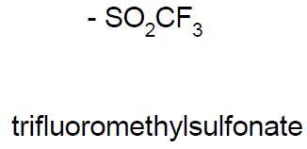
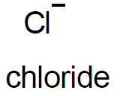
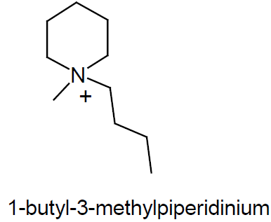
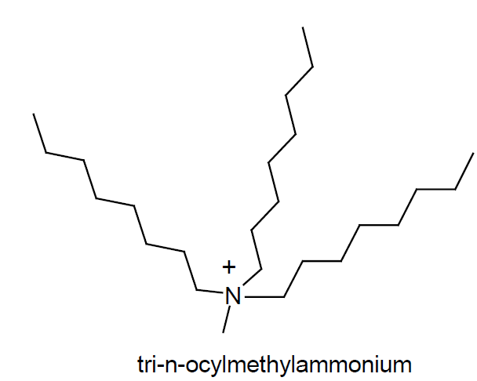
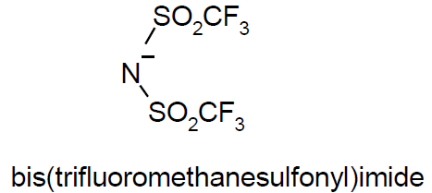
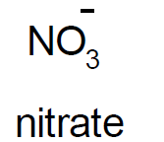
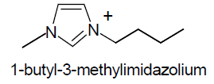
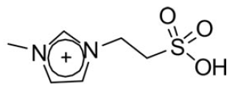
Examples of IL cations and anions
Can functionalize ILs
10¹⁸ possible combinations
Route for task specific properties
Group actinide separation

Slide 11
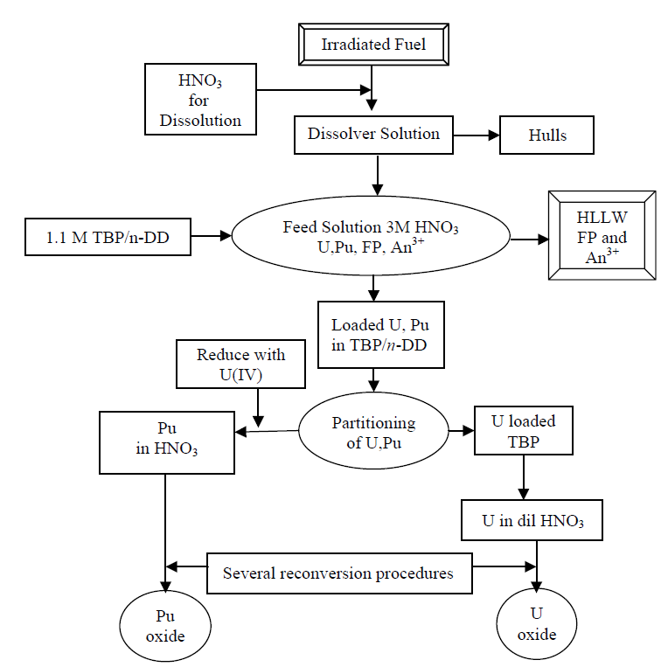
Ionic liquids in separations
Ionic liquids can replace traditional solvents in the PUREX
Studies showed favorable extraction when ILs used in conjunction with extractants
Chem. Commun. 1765 (1998)
Possible recovery of metals through electrodeposition
direct from the organic phase following solvent extraction
From J. Nucl. Radiochem. Sci., 10(1), 1-6 (2009)

Slide 12
f-element reduction in ionic liquids
Haloaluminates not stable to reduction of An(III) or Ln(III) to metal state
Development of moisture-stable ILs
good cathodic stability
large ~6V electrochemical windows
Application based upon the molten salt system (450 - 800°C)
Ionic liquids eliminate
Specialized corrosion resistant cell
Operation at elevated temperatures
Production of caustic side reactions
Electrochemistry of Sm³⁺, La³⁺, Eu³⁺ and Th⁴⁺ in [Me₃NBu][TFSI]
Reported reduction of Sm, La, and Eu to the metallic state
Th was reported to reduce to Th⁰ but subsequently was converted to ThO₂ by moisture in ionic liquid
Dalton Trans, 24, 4532-4534 (2002)
Role of water central, useful in dissolution by problematic in full reduction

Slide 13
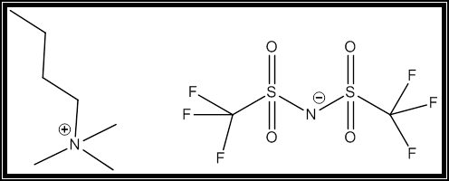
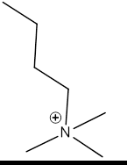
Choice of Ionic Liquid
A number of ionic liquids initially investigated
bis(trifluoromethanesulfonyl)imide (TFSI) anion selected for study at UNLV
Functionalized TFSI evaluated
propyl and imidazolium
large potential window with Au, Pt, and Glassy carbon electrodes
Suitable for reduction of lanthanides and actinides
Ionic liquid
N-trimethyl-N-butylammonium bis(trifluoromethanesulfonyl)imide
Used with actinides
Written as [Me₃NBu][TFSI]

Slide 14
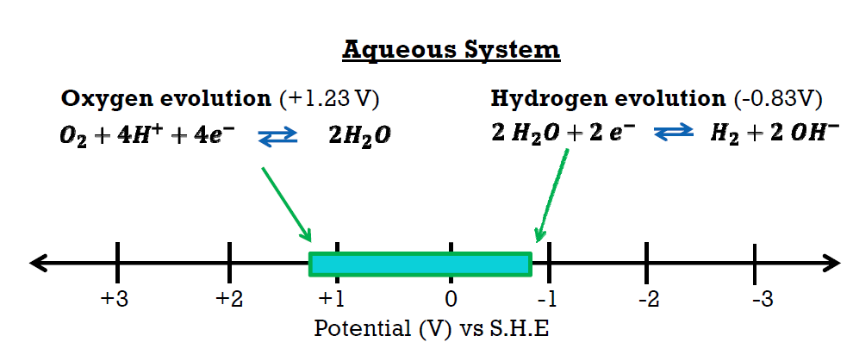
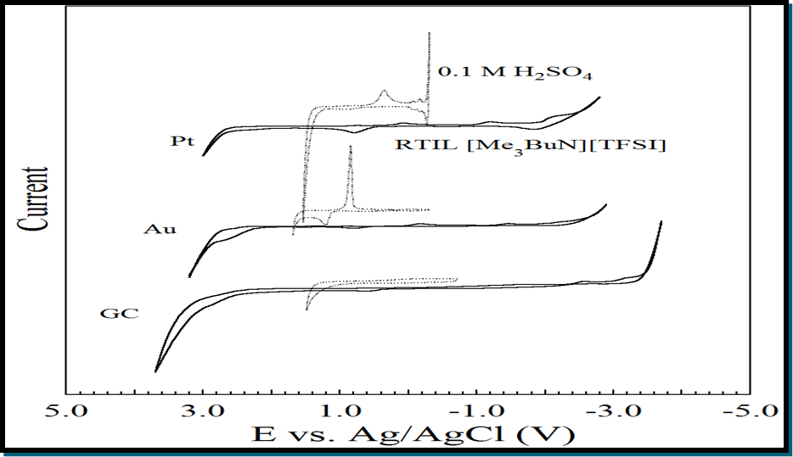
Electrochemistry in ionic liquids
ILs have wider potential window
Actinide electrochemistry possible
Must limit water in the system
TFSI is a poor ligand
Moves deposition to favorable potential
Electrode can influence window
Glassy Carbon (GC) widest potential window

Slide 15
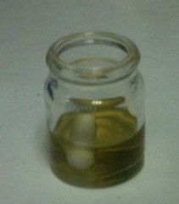
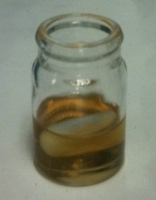
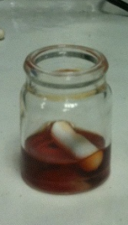
U TFSI compound synthesis
All reactions were performed in an argon filled glove box
K(TFSI)(s) synthesized by adding H(TFSI) and KH THF solution
K(TFSI) separated by decanting excess THF
90% yield
K(TFSI) and UI₃(THF)₄ dissolved in THF
Excess of K(TFSI) added to ensure reaction completion
Clear pale yellow solution was stirred for 24 hours
Final orange red solution
Contained off white KI solid precipitate
THF solution contained product U(TFSI)₃
Solid was isolated by evaporating excess THF
74% yield

Slide 16
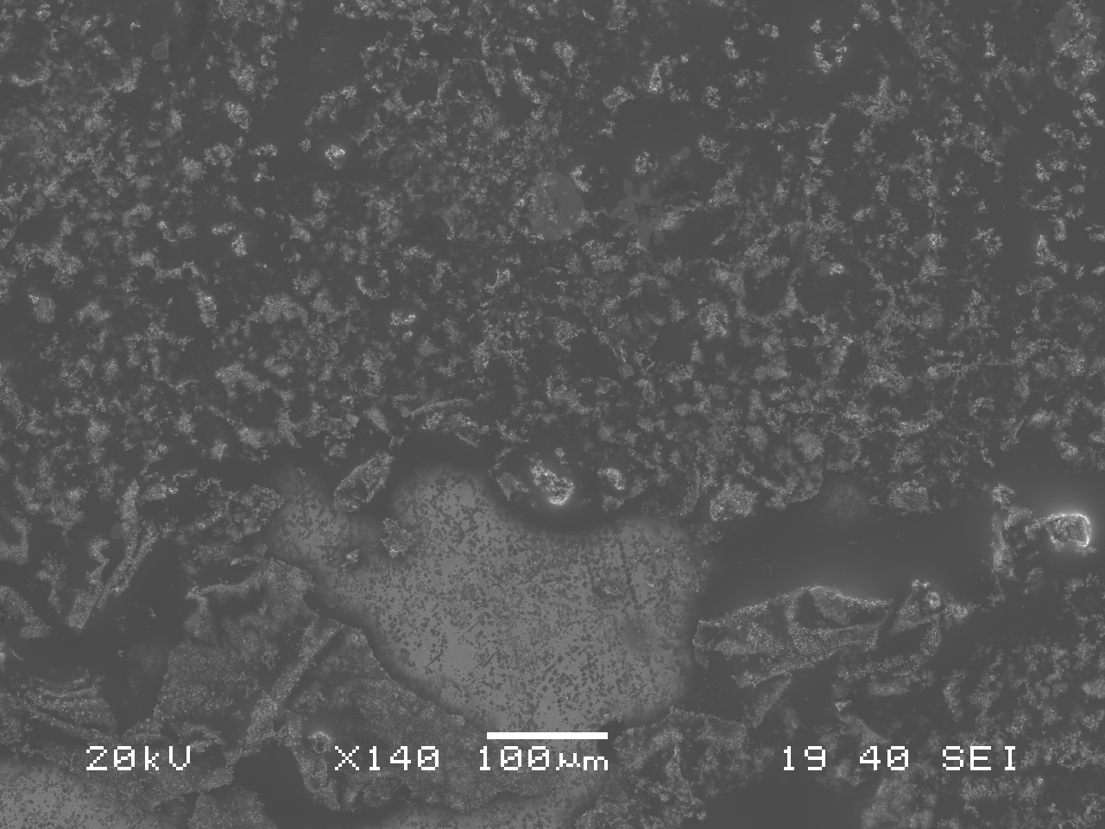
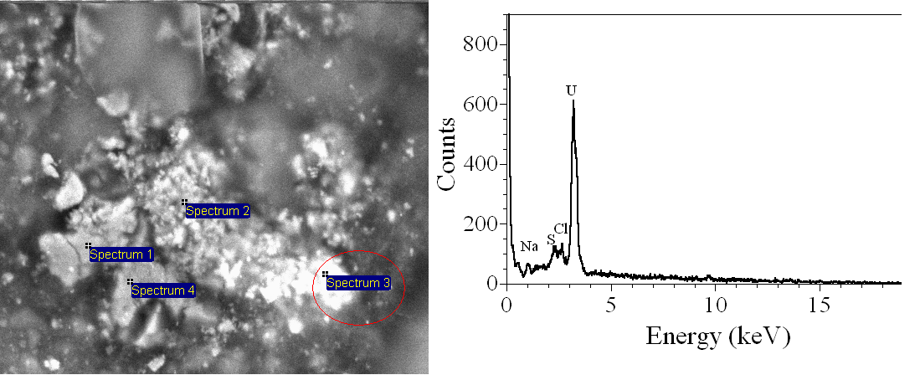
Formation of Uranium Deposits
Constant potential of -1.5 V versus NHE
SEM, EDS, and XRD analysis performed
SEM of U deposited on Au foil
XRD evaluation of sample
Alpha U metal
SEM EDS
No oxygen at 5.5 keV
U-metal deposit
Au electrode

Slide 17
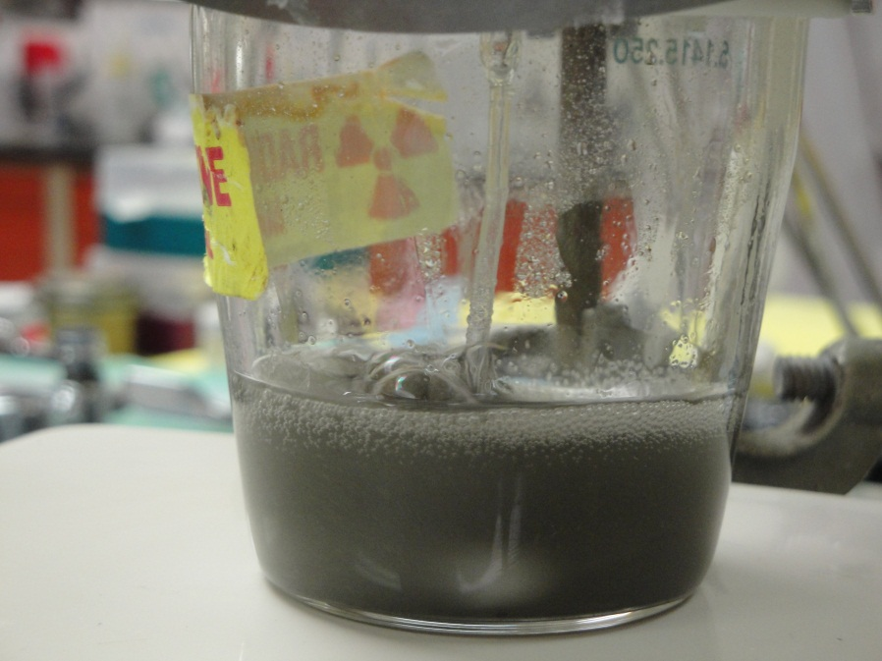
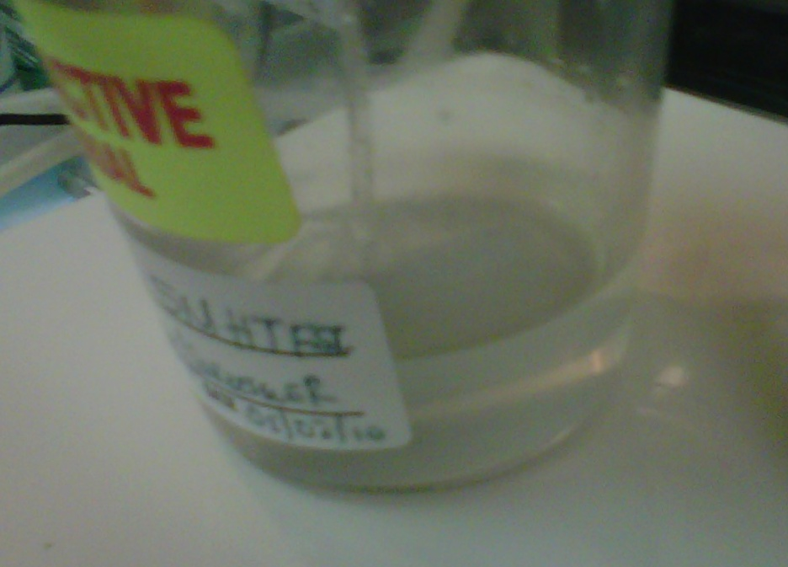
Direct dissolution of U₃O₈ into ionic liquid
Ozone
(From compressed air)
t = 24 hrs
Original dissolution conditions:
45 mg U₃O₈ with 3.27 M HTFSI in Me₃NBuTFSI Stirred for weeks with no change
RESULT: dissolution of material
oxidizing gas used
O₃, NO₂
Addition of HTFSI
Promote formation of uranium-TFSI complex

Slide 18
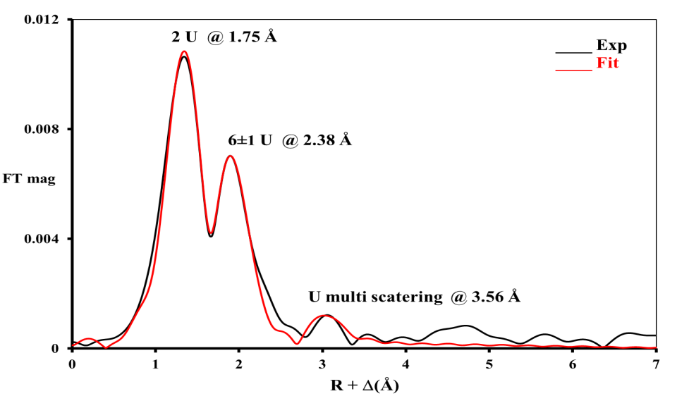
Direct dissolution of U₃O₈ into RTIL
Proposed dissolution mechanism:
U₃O₈ + 6 HTFSI + O₃ 3 UO₂²⁺ + 6 TFSI⁻ + 3 H₂O + O₂
2 O @ 1.75 Å
Supporting EXAFS data of the original dissolution solution
confirmed presence of UO₂²⁺
coordinated with five to six equatorial oxygens.
6 ± 1 O @ 2.38 Å
U --- O multi scattering @ 3.56 Å

Slide 19
RDCH 702: Lecture 9 Separations Part 3
Separation methods
Solvent extraction
PUREX
Ion exchange
Volatility
Electrochemistry
Specific actinide separations
Basic concept of separations
Oxidation state
Ionic radius
Development of advanced separations
Trivalent actinides
Necessary for fuel cycle due to formation of mixtures due to fission
Actinides
Transuranics
Fission products
Se (Z=34) to Dy (Z=66)
Tributyl phosphate (TBP)

